Slide 1
Upstate Continuum of Care
Spring 2024 Training
10:00-11:00
Emergency Solutions Grant
12:00-1:00
Lunch!
An overview of the ESG funding opportunity and application process.
11:15-11:45
Equal Access Rule and Preventing Family Separation
1:00-2:30
Small Groups
Guided small groups based on program type (ES, RRH, PSH, etc.)
11:45-12:00
2023 NOFO Funding and Scoring

Slide 2
W
E
E
L
C
O
M
Brooks Bryant, Project Care
Greenville/Laurens Chapter At-Large Member

Slide 3
Emergency Solutions Grant
Beth Rutherford, City of Spartanburg
CoC President
Bruce Forbes, SHARE
CoC Vice-President
Greenville/Laurens Chapter President

Slide 4
24 Code of Federal Regulations (CFR)
Part 576- Emergency Solutions Grant Program
“Know This,
Love This,
Live This”

Slide 5
The ESG program provides funding to:
Engage homeless individuals and families living on the street;
Improve the number and quality of emergency shelters for homeless individuals and families;
Help operate these shelters;
Provide essential services to shelter residents;
Rapidly re-house homeless individuals and families; and
Prevent families and individuals from becoming homeless.

Slide 6

Five Program Components
Street Outreach
Emergency Shelter
Homelessness Prevention
Rapid Re-Housing
HMIS

Slide 7
Eligible Recipients
Metropolitan cities, urban counties and territories may subgrant ESG funds to private nonprofit organizations.
  Greenville County is the only ESG-eligible entity in Upstate CoC (FY2023 $234,279)
State recipients must subgrant all of their ESG funds (except for funds for administrative costs and under certain conditions, HMIS costs) to units of local government and/or private nonprofit organizations. (FY2023 $2,456,769)

Slide 8

Street Outreach
Eligible costs include:
engagement,
case management,
emergency health and mental health services,
transportation,
services for special populations.
See 24 CFR 576.101

Slide 9
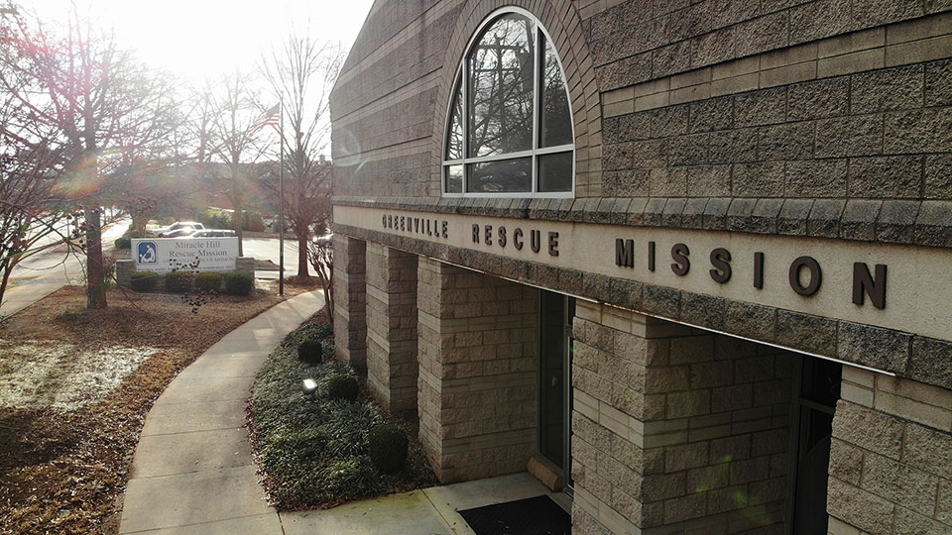
Emergency Shelters
Renovation, including major rehabilitation or conversion, of a building
Essential Services, including case management, child care, education services, employment assistance and job training, outpatient health services, legal services, life skills training, mental health services, substance abuse treatment services, transportation, and services for special populations.
Shelter Operations, including maintenance, rent, repair, security, fuel, equipment, insurance, utilities, food, furnishings, and supplies
See 24 CFR 576.102

Slide 10

Homeless Prevention
Eligible costs include:
Rental Assistance: rental assistance and rental arrears
Financial assistance: rental application fees, security and utility deposits, utility payments, last month's rent, moving costs
Services: housing search and placement, housing stability case management, landlord-tenant mediation, tenant legal services, credit repair
See 24 CFR 576.103.

Slide 11
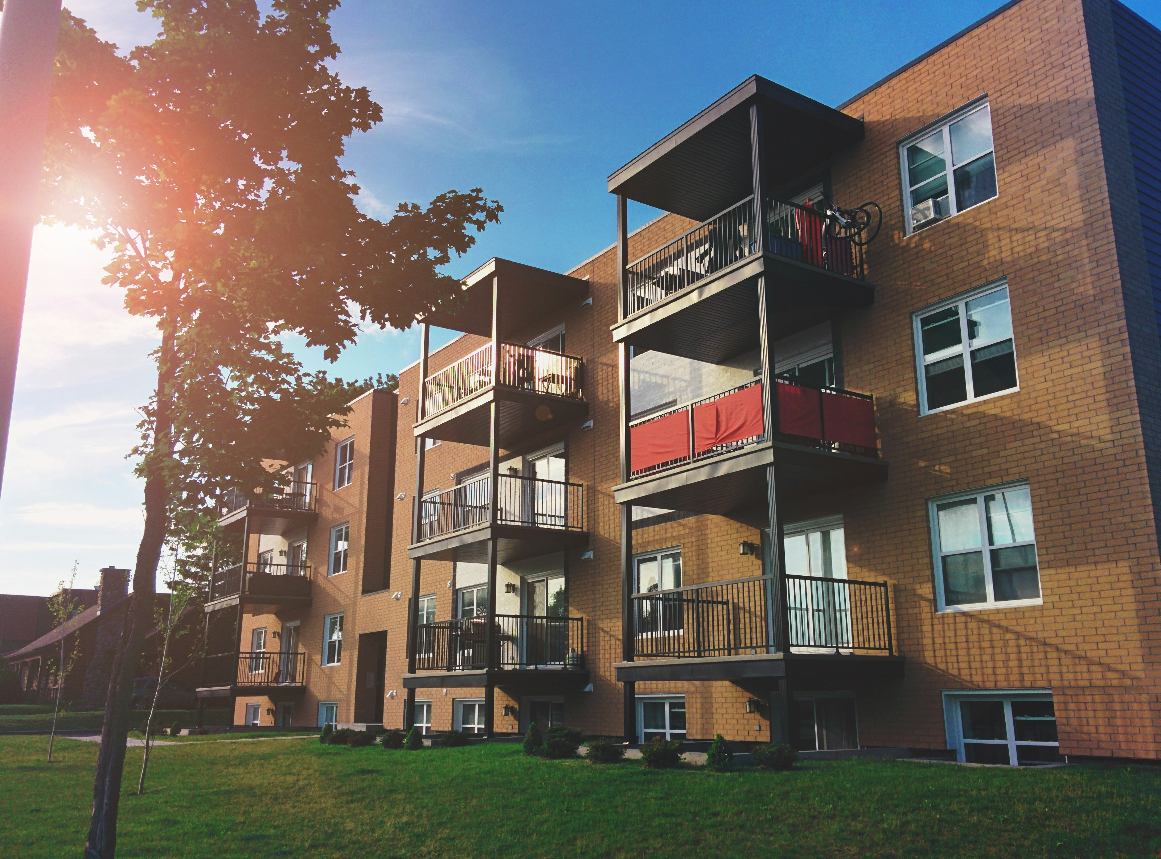
Rapid Rehousing
Eligible costs include:
Rental Assistance: rental assistance and rental arrears
Financial Assistance: rental application fees, security and utility deposits, utility payments, last month's rent, moving costs
Services: housing search and placement, housing stability case management, landlord-tenant mediation, tenant legal services, credit repair
See 24 CFR 576.104

Slide 12

Data Collection (HMIS)
ESG funds may be used to pay for the costs of participating in and contributing to the HMIS designated by the Continuum of Care for the area.
See 24 CFR 576.107

Slide 13
§ 576.2 Definitions – MUST FOLLOW
At risk of homelessness
Homeless
Also each of the 5 Components
  EXAMPLE: Street Outreach
    Engagement
    Case Management
    Emergency Health Services
    ETC.

Slide 14

Critical Items to Remember
§ 576.201 Matching requirement
  100% Match
Written standards for providing ESG assistance
Participation in HMIS
Recordkeeping
  Financial and Programmatic
§ 576.405 Homeless participation
  Need homeless or formerly homeless person on the Board or decision-making group

Slide 15
Application Process
For State ESG funding –
  SC Department of Administration, Office of Economic Opportunity (OEO)
  Michelle Dowlen, ESG Program Manager
  803-734-2454
  michele.dowlen@admin.sc.gov
For Greenville County ESG –
  Greenville County Redevelopment Authority
  Kristin Conley
  (864) 242-9801 ext. 124
  kconley@gcra-sc.org

Slide 16
Equal Access Rule and Preventing Family Separation
Natalie Rivera
Director of CoC Operations

Slide 17



28% of LGBTQ youth reported experiencing homelessness or housing instability at some point in their lives, and those who did had two to four times the odds of reporting depression and anxiety compared to those with stable housing.
48% of LGB couples experience adverse treatment when seeking senior housing.
34% of LGBT older adults fear having to re-closet themselves when seeking senior housing.
2022
2018

Slide 18
Proposed Rule vs. Final Rule
Proposed Rule: When a federal agency like HUD wants to implement a new regulation, they publish a proposed rule in the Federal Register and open it to public comment.
Final Rule: The proposed rule only becomes final when an agency can conclude that the proposed solution will help solve the identified problem and will be cost effective.

Slide 19

Background of Equal Access
2011: HUD released proposed rule, evidencing that LGBTQ+ persons were being arbitrarily excluded from some housing opportunities.
2012: Equal Access to Housing in HUD Programs Regardless of Sexual Orientation or Gender Identity became a final rule.
2016: Equal Access in Accordance With an Individual’s Gender Identity in Community Planning and Development Programs was proposed by HUD and later became a final rule.

Slide 20

Who does this rule apply to?
Mandatory for all programs funded by HUD’s Office of Community and Planning Development (CPD), including:
Community Development Block Grant (CDBG)
Continuum of Care (CoC)
Emergency Solutions Grant (ESG)
HOME Investment Partnership (HOME)
HOME- American Rescue Plan (HOME-ARP)
Housing Opportunities for Persons with AIDS (HOPWA)
Youth Homelessness Demonstration Program (YHDP)

Slide 21

Basics of 2016 Equal Access Rule
Any program funded by the CPD must be open to all eligible individuals and families regardless of their gender identity, sexual orientation, or household composition.
Gender Identity: The gender with which a person identifies, regardless of the sex assigned to that person at birth. This is different than perceived gender identity, which is the gender with which a person is perceived to be based on their appearance, behavior or expression.

Slide 22



Best Practices for Asking about Gender Identity
Leave an open-ended response for gender identity on intake forms.
Be respectful and direct to show equal regard for all identities. “How do you identify your gender?”
Be knowledgeable about modern LGBTQ+ terminology.

Slide 23

Response to Safety Concerns
HUD recognizes that there are security risks in operating shelters, but the obligation to provide for safety and security is not new, and the denial of equal access cannot be justified based on unfounded concerns about safety or security.
As HUD has noted, it has studied the issue for 4 years and determined, following the lead of other Federal agencies, that to ensure equal access, the general rule must be that individuals are accommodated in accordance with their gender identity

Slide 24

What is a nondiscriminatory step?
A service that you would provide to anyone in your housing program, regardless of their identity, to resolve a safety concern.
An exception to policies and procedures may be appropriate in such circumstances to avoid infringement on an individual's privacy concern.

Slide 25
Sexual Orientation and Household Composition
Sexual Orientation: One's emotional or physical attraction to the same and/or opposite sex (e.g., homosexuality, heterosexuality, or bisexuality).
A family is any group of persons presenting together for assistance.

Slide 26
Example 1:
You’re an emergency shelter that only serves families with children.
You cannot limit assistance to only women with children.
You cannot limit assistance to only heterosexual couples.
Example 2:
You’re a permanent supportive housing program that only serves chronically homeless families.
You cannot limit assistance to only households with children.

Slide 27



Accommodating Families to Avoid Involuntary Separation
Families can be sheltered together on “overflow” beds.
Families must be able to choose to stay in private family rooms if available.
You can leave a bed empty to accommodate a family.

Slide 28
Equal Access Scenarios
Someone from the Tri-County Chapter
Someone who has never been to a CoC Training Event
Someone who has had a positive experience receiving HMIS or CES training from Anna or Nona in the past year
Someone on the left side of the room
Someone that loves and cares about the CoC and would be willing to share the final scenario

Slide 29
2023 CoC Program Competition (NOFO) Funding and Scoring Methods
Candace Timmerman
CEO, United Housing Connections
CoC Chair

Slide 30
2023 Score Not Released Yet

Slide 31
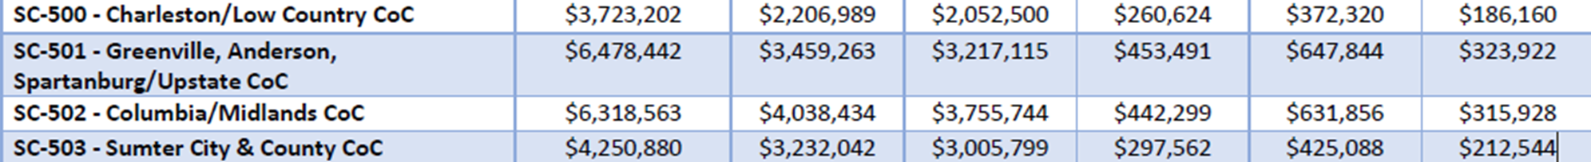
PPRN- Preliminary Pro Rata Need
Calculated using a formula that includes factors related to population size and poverty
ARD- Annual Renewal Demand
The dollar amount based on the budgets for each existing project that can be renewed in particular year (BASED ON GRANT INVENTORY WORK SHEET- GIW)
In each CoC, HUD and the COC agree on which grants they think are eligible for renewal as well as the amounts for those grants
FPRN- Final Pro Rata Need
Is either the same as PPRN or the estimated Annual Renewal Demand (ARD), whichever is higher, FPRN is a key for determining how much funding a CoC will be eligible to apply for.
The amount for each geographic area is based on population, poverty, housing overcrowding, and age of housing in each area.

Slide 32
Planning Grant and Bonus Funds
Planning Grant- CoC’s Collaborative Applicant to pay for staff and other costs related to operating the CoC
CoC Bonus and DV Bonus
CoC Interim Rule allows HUD to provide a bonus to geographic areas for activities that have been proven to be effective in reducing homelessness generally or for specific subpopulations listed in the NOFO or achieving homeless prevention and independent living
Goals established in the NOFO and to meet policy priorities set in the NOFO
All projects must pass eligibility and quality thresholds, but whether a project is awarded bonus funds is also contingent on the CoC’s application score and how the CoC ranked the project in the list of applications that it selects for submission to HUD

Slide 33
Why did renewal grants increase?
Increased in Annual Renewal Demand (ARD)
From increases in leasing, rental assistance, and operation
To keep up with rising fair market rents

Slide 34
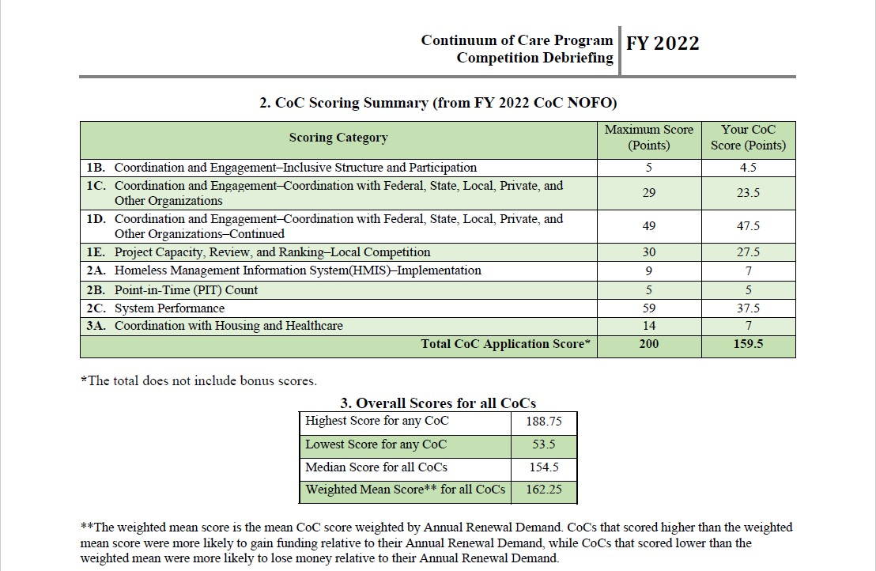

Slide 35
Coordination, Engagement, and System Performance
We continue to strive to improve:
Coordination with Federal, State, Local Private and other organizations
System Performance Measures such as:
  Number of Homeless Persons
  The Extent to which Persons Who Exit to Permanent Housing Destinations Return to Homelessness within 6, 12, and 24 months
Employment and Income Growth for Homeless Persons in CoC Program Funded Projects

Slide 36
2024 and Beyond
Where we can improve
Working to improve your project performance will affect not only your program but overall system performance in the Upstate CoC
Continue to apply for bonus funding and expand our ARD

Slide 37
Lunch!
Reconvene at 1pm
February is Black History Month!
Were you aware that in the 2023 PIT Count, 35% of the persons experiencing homelessness in the Upstate identified as Black, African, or African American? This is a noticeable overrepresentation when compared to the 26.3% of South Carolina residents that identified as Black or African American in 2023 Census.
Beatrice Thompson from Townville, SC was the first African American person elected to the Anderson City Council in 1976. At 90-years-old, she’s still in office.
Her philosophy: ““Give to the world the best that you have and the best will come back to you.”
Rodney Acker was the first African American football player for Furman University in 1970, the same year that Greenville County Schools fully integrated. Acker was also a great scholar- in 1969, he earned the highest SAT score among African Americans in Greenville County.
Lt. Col. Charity Adams from Columbia, SC was the first African American woman to be an officer in the Women’s Army Auxiliary Corps. She is the only African American woman with a military base named after her (Fort Gregg-Adams in Virginia).

Slide 38
Small Groups
Reconvene at 2pm
Rapid Rehousing and
Transitional Housing
Bruce Forbes and Summer Glover, SHARE
Outreach
April Nations and Steven Greer, City of Spartanburg
Permanent Supportive Housing
Michelle Gerald and Susan King, UHC
Emergency Shelter
Laruen Stephens and Taylor Young, Salvation Army of Greenville
Homeless Prevention
Beth Rutherford, City of Spartanburg
Sarah Daniel, United Way of the Piedmont

