Slide 1
2024 NOFO Day of Learning
Part one: 2023 NOFO Scoring Debrief

Slide 2
Super Quick introductions
Your name and organization
On a scale of 1 to 10, how involved do you feel in the Upstate CoC
If you can think of it, one sentence on how UHC and our Executive Committee can help create an environment where everyone feels informed and involved in the CoC

Slide 3
What to expect from this session
This session is designed to review our 2023 NOFO scoring results and brainstorm ideas on how to recover points in the future.
I will be presenting content to you, but we will have opportunities for discussion on each NOFO standard discussed today. Please feel free to speak up in person or on Zoom (or raise your hand on Zoom if that’s easier) at any time.
At the end of this session, the goal is to identify which standards we can quickly recover as a CoC and have some direction on how to best implement our targeted actions. I will take informal notes from this recorded training to share our ideas from today with the CoC Advisory Council.

Slide 4
NOFO: Notice of Funding Opportunity
The actual NOFO is the written announcement that signifies the beginning of the annual CoC Program Funding Competition. But when we talk about the Funding Competition, we often refer to whole process as the “NOFO”.
The NOFO (the whole process) is made up of two parts:
Agencies that are seeking funding from the CoC will submit their project applications, whether they are creating a new project or renewing an existing project.
The Lead Agency/Collaborative Applicant, United Housing Connections, will submit a Collaborative Application. The Collaborative Application is a long, narrative-based application that summarizes the work we’re doing as a coalition– not just the work of one agency. This is what is scored by HUD.

Slide 5
Overview of 2023
In 2023, we scored 134.75 points out of 200 points possible on our Collaborative Application. This score was lower than the national median in 2023, which was 151.5 points. It was also lower than our score in 2022, which was 159.5 points.
We were not awarded bonus funds in Tier 2 to create new projects, meaning our CoC’s overall score was lower than the cut-off percentile.
How HUD gives us our score:
C:\Users\NatalieWilson\United Housing Connections\HMIS-Documents\NOFO\NOFO 2023\2023 NOFO Score.pdf
How we determine where we lost points:
C:\Users\NatalieWilson\United Housing Connections\Upstate CoC - Documents\NOFO\2023 NOFO\2023 NOFO Rubric.pdf

Slide 6
Inclusive structure
0.25 Points
Certain agencies that HUD would like to participate in CoC meetings, being elected as Voting Members, and participate in our Coordinated Entry System:
Indian Tribes and Tribally Designated Housing Entities
Local Jails
Agencies serving survivors of human trafficking
Organizations led by persons who identify as LGBTQ+
LGBTQ+ Advocacy organizations
Crisis Response Teams

Slide 7
Coordination and engagement
9.5 Points
In the past year, did the CoC hold mandatory or optional trainings for members on the Equal Access Rule and on Preventing Involuntary Family Separation (we will recover estimated 3 points)
We must “indicate coordination with other federal, state and local governments; private; and other organizations that are included in the planning or operation of projects.”
We were not able to indicate coordination with:
Indian Tribes and Tribally Designated Housing Entities
Temporary Assistance for Needy Families (TANF)

Slide 8
Coordination and engagement
9.5 Points
“Demonstrate the CoC coordinates to provide education services to families with children between the ages of 0-5; and collaborates with education providers, local educational authorities, and school districts.”
Our CoC grantees do not have formal written agreements/partnerships with:
Birth to 3 Years
Child Care and Development Fund
Early Childhood Providers
Early Head Start
Head Start
Healthy Start
Public Pre-K
Federal Home Visiting Program

Slide 9
Coordination and engagement
9.5 Points
Our CoC must coordinate with Public Housing Agencies. We were not able to attest that we:
“Ensure at least 20 percent of new PHA admissions were individuals or families experiencing homelessness at admission.”
Include units from the following PHA programs in our CoC’s Coordinated Entry System:
Family Unification Program (FUP)
Mainstream Vouchers
Non-Elderly Disabled (NED) Vouchers
Public Housing

Slide 10
Street outreach coverage
3 Points
The CoC must describe how our Street Outreach programs cover 100% of the CoC’s geographic area. Last year, we were not able to account for Street Outreach in:
(*Connected with SCDEW Rural Outreach Coordinator)
Pickens
Cherokee*
Union*
Laurens*
Abbeville*
McCormick*
Edgefield
Saluda

Slide 11
Public health agencies
2 Points
“The CoC coordinates with state and local public health agencies to respond to and prevent infectious disease outbreaks among people experiencing homelessness.”
Measured on how well we:
Share information related to public health and homelessness
Facilitated communication with public health agencies to prevent/limit infectious disease outbreaks, particularly in street outreach and shelter

Slide 12
ADVANCING RACIAL EQUITY
0.5 Points
The CoC was able to talk about:
Our work developing our DEIB Committee
Street Outreach programs that cover counties where minority racial groups are overrepresented in the homeless population
Attest that we have diverse representation on our Advsiory Council
I believe we only lost 0.5 points because our last Racial Equity Analysis was conduced in 2019.

Slide 13
5 Minute break

Slide 14
Project rating tools
3 Points
The CoC has two rating tools to rate our applicant competitively: one for new projects and one for renewing projects. New in 2023, our rating tools must have a standard that awards points to projects “based on the degree to which their project has identified any barriers to participation (e.g., lack of outreach) faced by persons of different races and ethnicities, particularly those over-represented in the local homelessness population, and has taken or will take steps to eliminate the identified barriers”
The CoC Grants Committee is working to develop this
standard. We should recover 3 points once implemented.

Slide 15
HMIS Utilization RATES
3.5 Points
The CoC must have 85% HMIS utilization rates for the following project types:
Emergency Shelter (35%)
Safe Haven (100%)
Transitional Housing (58%)
Rapid Rehousing (100%)
Permanent Supportive Housing (100%)
Other Permanent Housing (N/A)
We have a chance to recover partial points with a detailed
plan for increasing utilization over the next year.
Unfortunately, we will lose PSH in 2024 because
HUD-VASH is no longer participating.

Slide 16
Point in time count
12 Points
The CoC is awarded the following point values for each standard. Our CoC did not achieve these last year and will not achieve them this year:
2 points for a 5% decrease in sheltered population
7 points for a 5% decrease in unsheltered population
3 points for a 5% decrease overall
 | Sheltered | Unsheltered | Total
2023 | 1048 | 376 | 1424
2024* | 1054 | 615 | 1669
*Subject to small changes, not finalized at this time

Slide 17
System performance measures
18 Points
8 points for reducing the average Length of Time Homeless by at least 5%. Calculated by the number of days people spend in HMIS shelters and Safe Havens.
2021: 131 Days
2022: 155 Days (reported in 2023 NOFO)
2023: 192 Days (will be reported this year)
6 points for increasing the rate at which persons exiting RRH, TH, ES, and SH projects exit to permanent housing by 2%.
2021: 40%
2022: 37% (reported in 2023 NOFO)
2023: 43% (will be reported this year)
We will recover these 6 points.

Slide 18
System performance measures
18 Points
2 points for increasing the percentage of persons who had an increase in employment income, or that the rate was 20% or higher.
STAYERS
2021: 2%
2022: 4% (reported in 2023)
2023: 5% (will report this year)
2 points for increasing the percentage of persons who had an increase in non-employment income, or that the rate was 50% or higher.
STAYERS
2021: 49%
2022: 25% (reported in 2023)
2023: 65% (will report this year)
LEAVERS
2021: 6%
2022: 5% (reported in 2023)
2023: 10% (will report this year)
LEAVERS
2021: 11%
2022: 8% (reported in 2023)
2023: 14% (will report this year)

Slide 19
NEW APPLICANT AGREEMENTS
14 Points
7 points if a New Applicant has a formal written agreement to be able to utilize housing subsidies or subsidized housing units which are not funded through the CoC or ESG in their program.
7 points if a New Applicant has a formal written agreement with a healthcare provider, promising some form of services to program clients.

Slide 20
Improved over
the past year
Still needing improvement
Conducted trainings on Equal Access and Preventing Family Separation
Increased Street Outreach coverage
Developing a racial equity standard on our Rating tools
Improvements in our System Performance Measures:
Exits to permanent housing
Increase of employment income
Increase of non-employment income
Relationships with Public Housing Authorities and Public Health Agencies
Greater involvement from specific organizations
LGBTQ+
Tribal Organizations
Local Jails
Early Childhood Development
HMIS Utilization Rates
Reducing average Length of Time Homeless
Keep in mind that these improvements are based off the 2023 NOFO standards. Standards are known to shift throughout the years, and it’s not uncommon for new standards to be introduced. This is not meant to be an assured listing of points we will recover in 2024.

Slide 21
2024 NOFO Day of Learning
Part two: new applicant training

Slide 22
What to expect from this session
This session is designed to help breakdown the application process for agencies that are interested in applying for CoC funds for the first time.
I will be presenting content to you, but we will prioritize opportunities for discussion. Please feel free to speak up in person or on Zoom (or raise your hand on Zoom if that’s easier) at any time.
At the end of this session, the goal is that you leave with a general understanding of the NOFO application process, and you know where to look for additional resources.

Slide 23
Before we start
It’s important to note that the Upstate CoC is not guaranteed the ability to create new projects with bonus funds every year. In other words, if you apply for a project, we cannot guarantee it will be funded.
This is a competitive process in two ways: we compete with other CoC’s across the nation, and our local grantees compete with each other.
We will discuss the determinations for bonus funds later in this training.

Slide 24
NOFO: Notice of Funding Opportunity
The actual NOFO is the written announcement that signifies the beginning of the annual CoC Program Funding Competition. But when we talk about the Funding Competition, we often refer to whole process as the “NOFO”.
The NOFO (the whole process) is made up of two parts:
Agencies that are seeking funding from the CoC will submit their project applications, whether they are creating a new project or renewing an existing project.
The Lead Agency/Collaborative Applicant, United Housing Connections, will submit a Collaborative Application. The Collaborative Application is a long, narrative-based application that summarizes the work we’re doing as a coalition– not just the work of one agency. This is what is scored by HUD.

Slide 25
Eligible applicants and project types
Eligible Applicants: Nonprofit organizations, faith-based organizations, Indian Tribes or Tribally Designated Housing Entities, States, local governments, and instrumentalities of State or local governments are eligible to apply for grants.
Project Types:
Rapid Rehousing (RRH)
Permanent Supportive Housing (PSH)
Joint Transitional Housing and Rapid Rehousing (TH/RRH)
Supportive Services Only
FAQ: Can I use CoC funds to support a project that already exists?
Eligible applicants and project types are always listed in the current NOFO announcement. 2023 NOFO

Slide 26
1
Threshold Requirements
Minimum HUD and Local requirements that your agency must meet to be considered for CoC funding.
2
Application Timeline
Local competition timeline, including dates when your application is due for review and for final submission.
3
Rating and Ranking
Overview of process for rating new projects and creating our CoC’s Priority Listing.

Slide 27
Step one
HUD threshold requirements
Active registration in System for Award Management (SAM) and UEID number
Meets the eligibility requirements listed in the HEARTH Act and the CoC Program Interim Rule
.
Submits required certification in the NOFO, including Certification of Drug Free Workplace, Certification Regarding Lobbying, etc.
Applicant demonstrates financial and management capacity to carry out the project and has no outstanding delinquent federal debts
Understands that false statements are ground for denial or termination of award
Agrees to participate in the local HMIS system (CoC’s database for tracking services administered to clients)

Slide 28
Step one
local threshold requirements
Project proposed adheres to Housing First principles and/or Low Barrier Implementation
Project proposed is financially feasible, as determined by the Grants Committee
Applicant can provide evidence of documented, secure minimum match
Applicant has at least one member with lived experience of homelessness on their Board of Directors
Applicant has attended 75% of Advisory Council meetings in the past year
Applicant agrees to receive clients from the Coordinated Entry System
The most current version of the Threshold Requirements are located on the CoC’s website, under the Funding page.

Slide 29
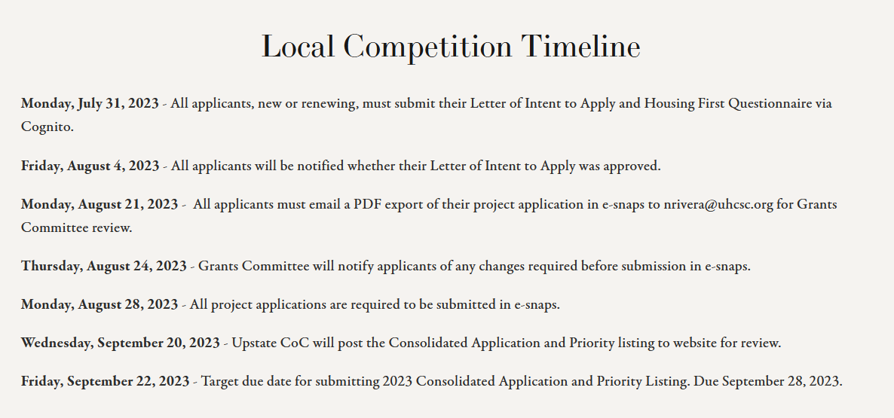
Step two
Application timeline

Slide 30
Letter of intent
to apply
Housing first
questionnaire
2023 Example Form: https://www.cognitoforms.com/unitedhousingconnections1/_2023nofoletterofintentfornewprojectsorrenewalprojectswithnodatatoreport
2023 Example Form: https://www.cognitoforms.com/unitedhousingconnections1/_2023upstatecontinuumofcarehousingfirstselfquestionnaire
Give yourself plenty of time to construct narrative on your agency’s project design, history of service, staff capacity, and grant management procedures.
Confirmation of Eligibility (ex. 501(c)3 status)
Most Recent Financial Audit
Attest that you understand and will implement Housing First procedures
The CoC is required to have at least 75% of our projects meeting Housing First, but it’s 10% of your project application score.
**(RRH and TH/RRH must be Housing First)
The links included in this presentation are from the 2023 NOFO and are meant to serve as examples. The content of the Letter of Intent and Housing First Questionnaire may change.

Slide 31
Step two
New project application
Set up your agency’s profile in e-snaps
Establish the project application through Funding Opportunity Registration
Complete project application (HUD provides Detailed Instructions)
Attest to required certifications
Project Description
Supportive Services
Population Served
Budget Breakdown
Send PDF version of completed application to Grants Committee for review
May suggest minor tweaks to application based on Grants Committee expertise
Final submission of project application (Checklist)

Slide 32
Step three
Rating new projects
In every NOFO, the CoC must create a Priority Listing that ranks all of our applicants (new and renewing) based on performance or predicted positive impact on our Continuum’s performance measures.
To determine a project’s performance, we use a Renewal Rating Tool and a New Project Rating Tool. These tools produce a numeric value to help us compare our applicants.
The most current version of the New Project Rating Tool is located on the CoC’s website, under the Funding page.
As of 2024, the Grants Committee is working to make edits to the New Project Tool to help compare new projects to renewing projects.

Slide 33
Step three
Creating our priority listing
ranking process
CoC procedure
HUD Provides the CoC with our Annual Renewal Demand (ARD), which is equal to all of the projects eligible for renewal.
We are also given an estimated CoC Bonus and DV Bonus.
We are allowed to put 93% of our ARD in Tier 1, and the rest has to go in Tier 2.
All Tier 2 projects are funded by the same criteria, no matter if they are CoC Bonus, DV Bonus, renewals, or reallocations:
50 points based on CoC score
40 points based on position on Priority Listing
10 points based on Housing First
Grants Committee creates the Priority Listing based solely on project score. We have historically placed new projects under renewal projects (Tier 2), since the CoC feels losing an existing project would be more damaging. However, this practice is up for discussion.
Rating and Ranking committee reviews the Priority Listing and has full discretion to rearrange the listing if needed. They may elect to prioritize projects that serve certain populations, such as youth or victims or domestic violence.

Slide 34
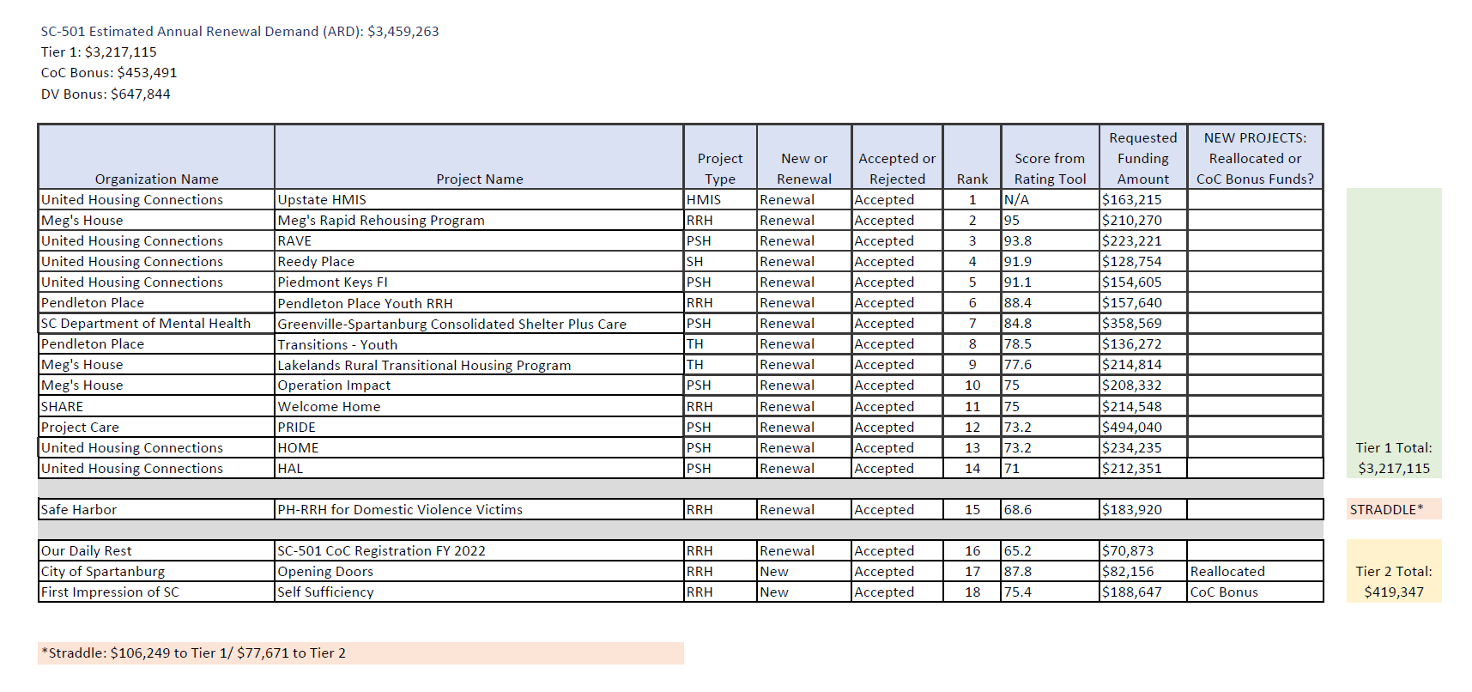
Step three
Creating our priority listing

Slide 35
Increasing our chances for bonus funds
In the first session today, we covered steps for the whole CoC to follow to improve our NOFO score and increase our chances for bonus funds.
What new applicants can focus on:
Developing written formal agreements to be able to utilize housing subsidies or subsidized housing units which are not funded through the CoC or ESG in their program.
Developing written formal agreements with a healthcare provider, promising some form of services to program clients.
Helping increase our HMIS utilization rates

Slide 36
2024 NOFO Day of Learning
Part three: expansion q&A for renewals

Slide 37
What to expect from this session
This session is designed to for existing CoC grantees that are interested in applying for an expansion grant to increase their total award.
Because this is a Q&A, I will not have too much content to present and will prioritize any questions you may have. Please feel free to speak up in person or on Zoom (or raise your hand on Zoom if that’s easier) at any time.
At the end of this session, the goal is that you leave with an understanding on how to submit an expansion grant application and how that application will be ranked in our Priority Listing.

Slide 38
Renewal basics
All applicants will have to complete Part One every year. Part One of the application includes a review of application type, applicant profile, Congressional Districts, certification on a drug-free workplace, certification on lobbying, etc.
If it’s your first year renewing, you will still have to complete the remainder of the application, though most information auto-fills.
If it’s your second or greater year renewing, you have the opportunity to Submit Without Changes. This greatly reduces the pages you have to review.
You may not Submit Without Changes if:
HUD placed a condition on last year’s application requiring your organization to adjust information (e.g., units, unit configuration, BLIs)
You executed a grant agreement amendment resulting in changes needed to the renewal project application

Slide 39
Renewal basics
You are limited as to what you can change on your renewal grant:
Add or edit a subrecipient
Review and update project description
Review and update services provided
Review and update sources of match
You may change your households/persons served if your budget is being reduced due to reallocation.
You may not request an increase in a renewal project’s total Annual
Renewal Amount (ARA).
You may not request any shifting of funds of more than 10 percent from one budget line item (BLI) to another BLI, unless it is due to reallocation.
You may not request a change in the configuration counts in units or bedrooms in a Rental Assistance BLI, unless it is due to reallocation.

Slide 40
consolidation
Combining two or more renewing projects with the same agency and the same component type.
reallocation
Relinquishing full or partial awards to create opportunities for new projects or project expansions.
transition
Process of changing a project’s component type over a one-year period.

Slide 41
expansion
The process used by renewal project applicants to submit a new project application to add funds to a project to expand its current operations by adding units, beds, persons served, services provided to existing program participants.
Existing Renewal: Submit renewal application with the activities and budget as written in current grant agreement. The project name of the existing renewal should match the project name on the GIW.
Expansion: Create and submit a new project application that includes the activities and budget for the newly expanded portion of the project. The name of the expansion should be the same as the existing renewal, with “Expansion” tagged on the end.
**Expansions can be created with CoC bonus funds, DV bonus funds, or reallocated funds. The exception is that DV Bonus funds cannot be used to expand a PSH project.

Slide 42
Allowed in expansion
Not allowed in expansion
Expand your existing program to serve additional program participants
Provide current participants with an expanded level of services
Provide current participants with facilities that meet health and safety standards
Provide the same activities that are CoC Program-eligible, but were previously funded by another source
You cannot use the expansion process to provide existing program participants with the same housing and services already funded through the CoC Program
Requests for capital costs (i.e., new constructions, rehabilitation, or acquisition) are ineligible and will be rejected in the expansion process
These are excerpts from the 2023 NOFO announcement and are intended to serve as an example. Allowable actions are subject to change and will be outlined in most current NOFO.

Slide 43
Ranking expansion grants
For the sake of the Priority Listing, Expansion grants will be rated and ranked the same as new projects. That means they will rated using the New Project Rating Tool instead of the Renewal Project Rating Tool.
Traditionally, our CoC has placed new projects in Tier 2, as we have determined that losing an existing project would be more damaging that not creating a new one. The same ideology leads us to placing Expansion grants in Tier 2.

Slide 44
Any additional questions?
You can always reach out to Natalie or Candace with any questions or for assistance.

